Slide 1
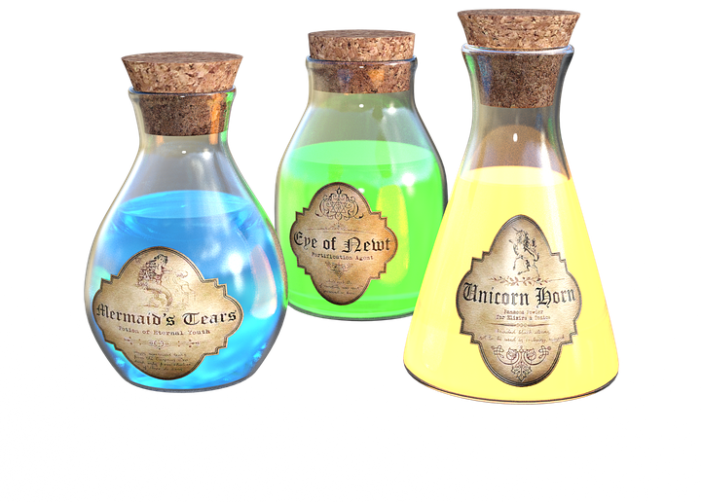
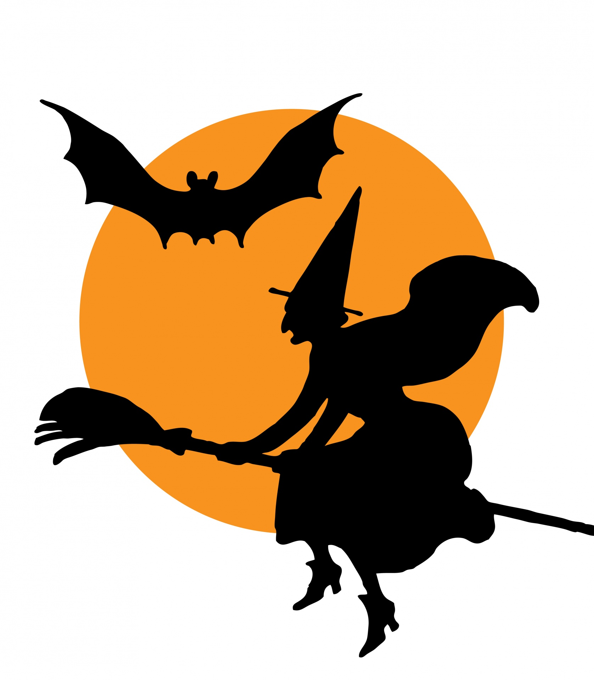
POTIONS
Spooky Halloween Science

Slide 2
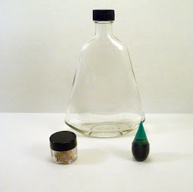
Materials
Small plastic or glass bottles with lids
Alcohol solution
Mica powder
Food coloring
Glow powder
Slurpy straw

Slide 3
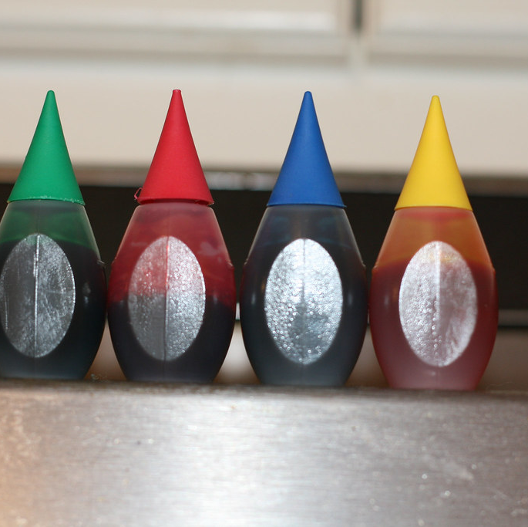
Step 1.
Add food coloring into bottle
This Photo by Unknown Author is licensed under CC BY

Slide 4
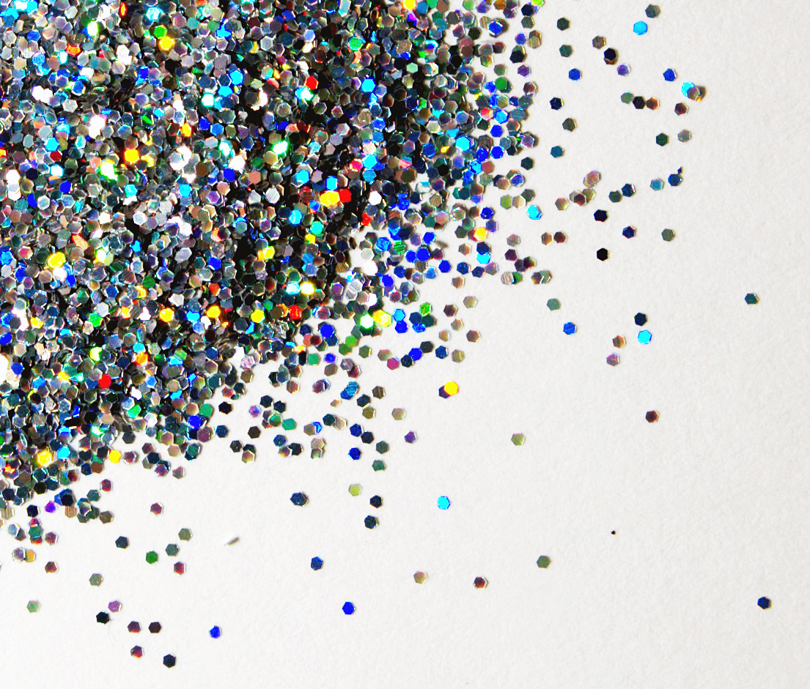
Step 2.
Using the slurpy spoon, scope a small amount of mica powder. Place scope into the bottle.
This Photo by Unknown Author is licensed under CC BY-SA

Slide 5
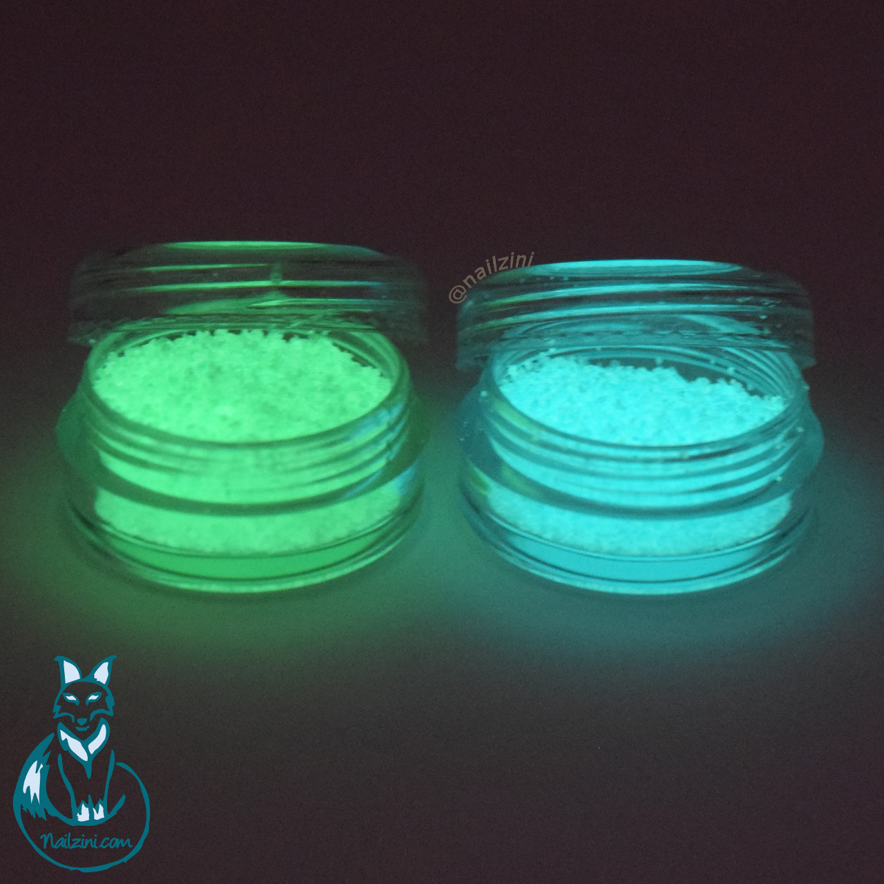
Step 3.
Use the slurpy spoon to scope a small amount of glow powder and place into the bottle.
This Photo by Unknown Author is licensed under CC BY-NC-ND

Slide 6
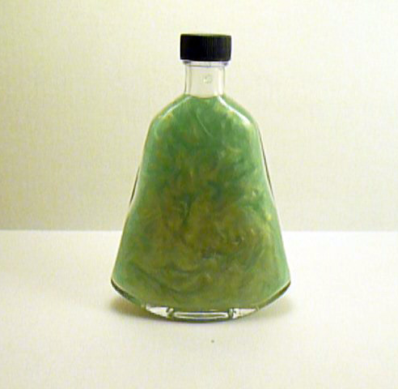
Step 4.
Fill the plastic bottle with the alcohol solution

Slide 7
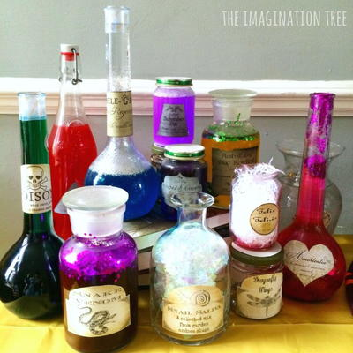
Your Potions Are complete!
Tighten the lid *add super glue for permanent lock*

