Slide 1
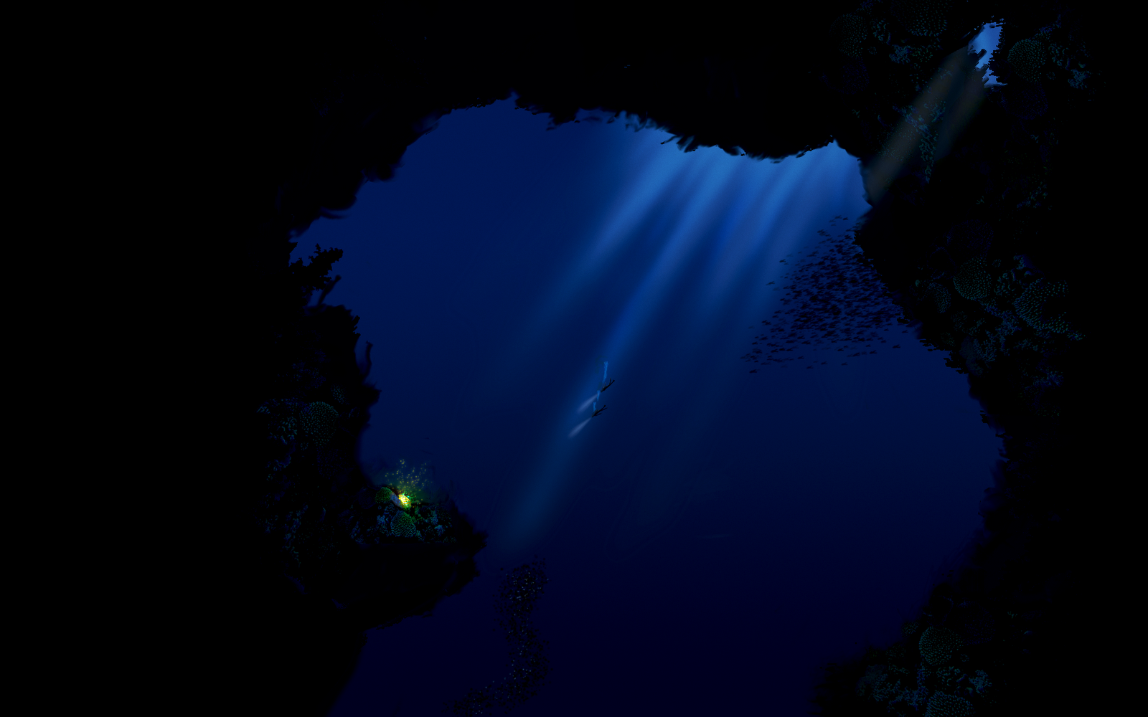
Bioluminescence
This Photo by Unknown Author is licensed under CC BY-NC-ND

Slide 2
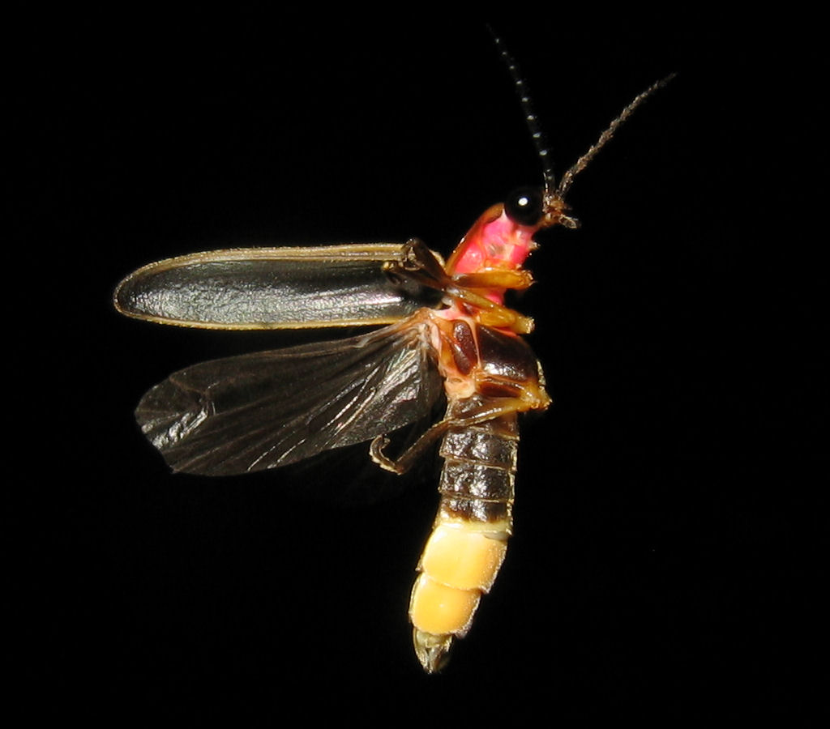
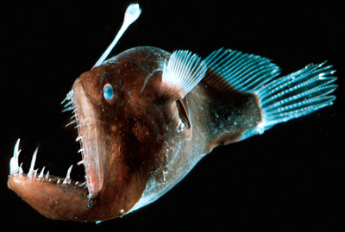
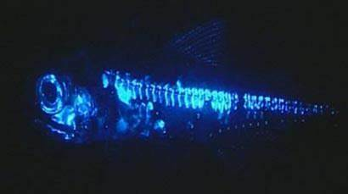
What is bioluminescence?
The biochemical emission of light by living organisms such as fireflies and deep-sea fishes.
Firefly Angler fish Lantern Fish
This Photo by Unknown Author is licensed under CC BY-SA
This Photo by Unknown Author is licensed under CC BY-SA

Slide 3

You might remember the example of bioluminescence from the movie
“Finding Nemo”
https://youtu.be/iNzmBDzw3XY

Slide 4
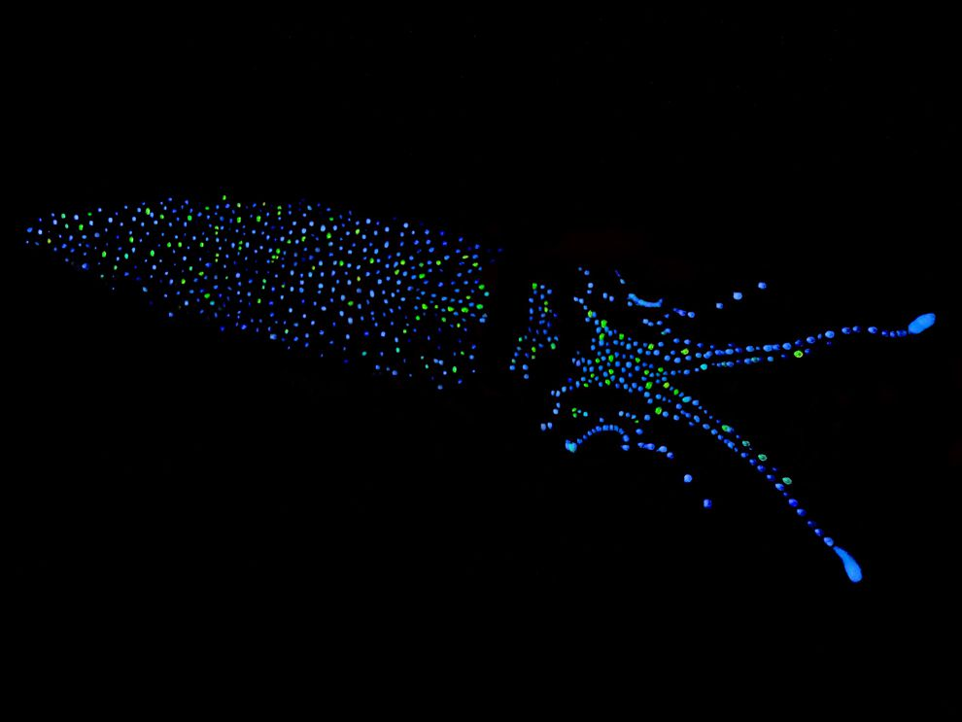
Bioluminescence is a type of chemiluminescence.
Which is simply the term for a chemical reaction where light is produced.
Firefly Squid

Slide 5
The 2 (two) chemicals involved with bioluminescence are called:
Luciferin
and
Luciferase or Photoprotein

Slide 6
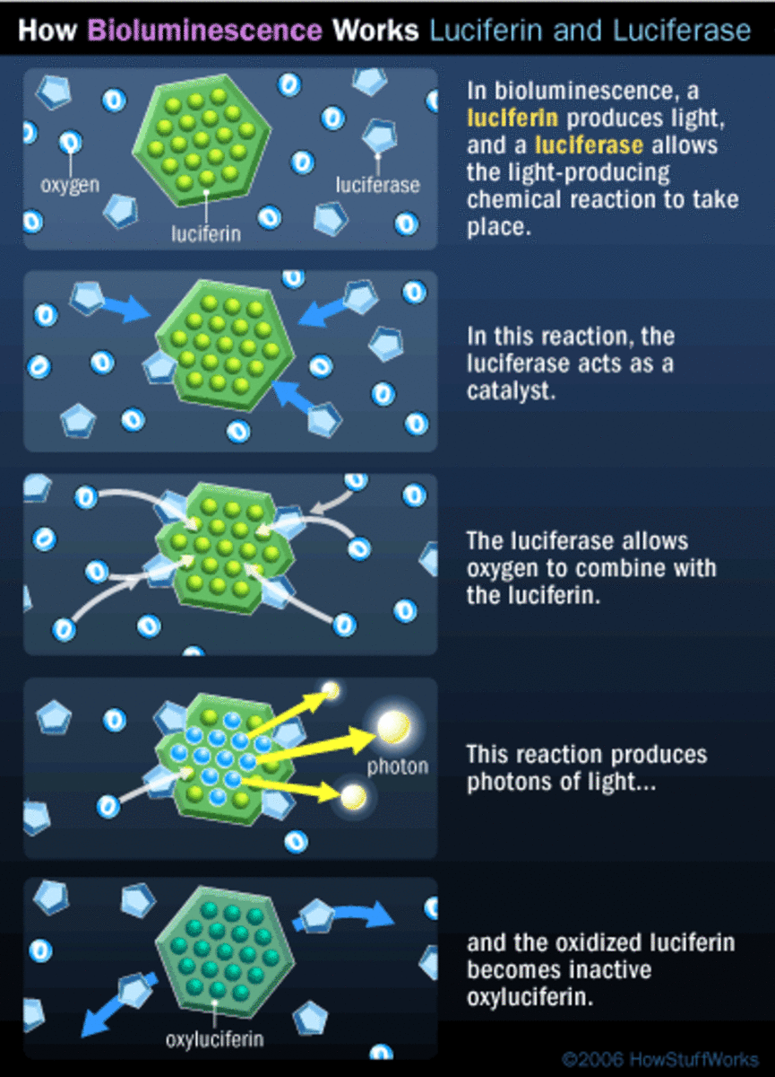
Luciferin is the compound that actually produces light.
In a chemical reaction, luciferin is called the substrate.
Luciferase is an enzyme.
An enzyme is a chemical (called a catalyst) that interacts with a substrate to affect the rate of a chemical reaction.
The interaction of the luciferase with oxidized (oxygen-added) luciferin creates a byproduct, called oxyluciferin.
More importantly, the chemical reaction creates light.

Slide 7
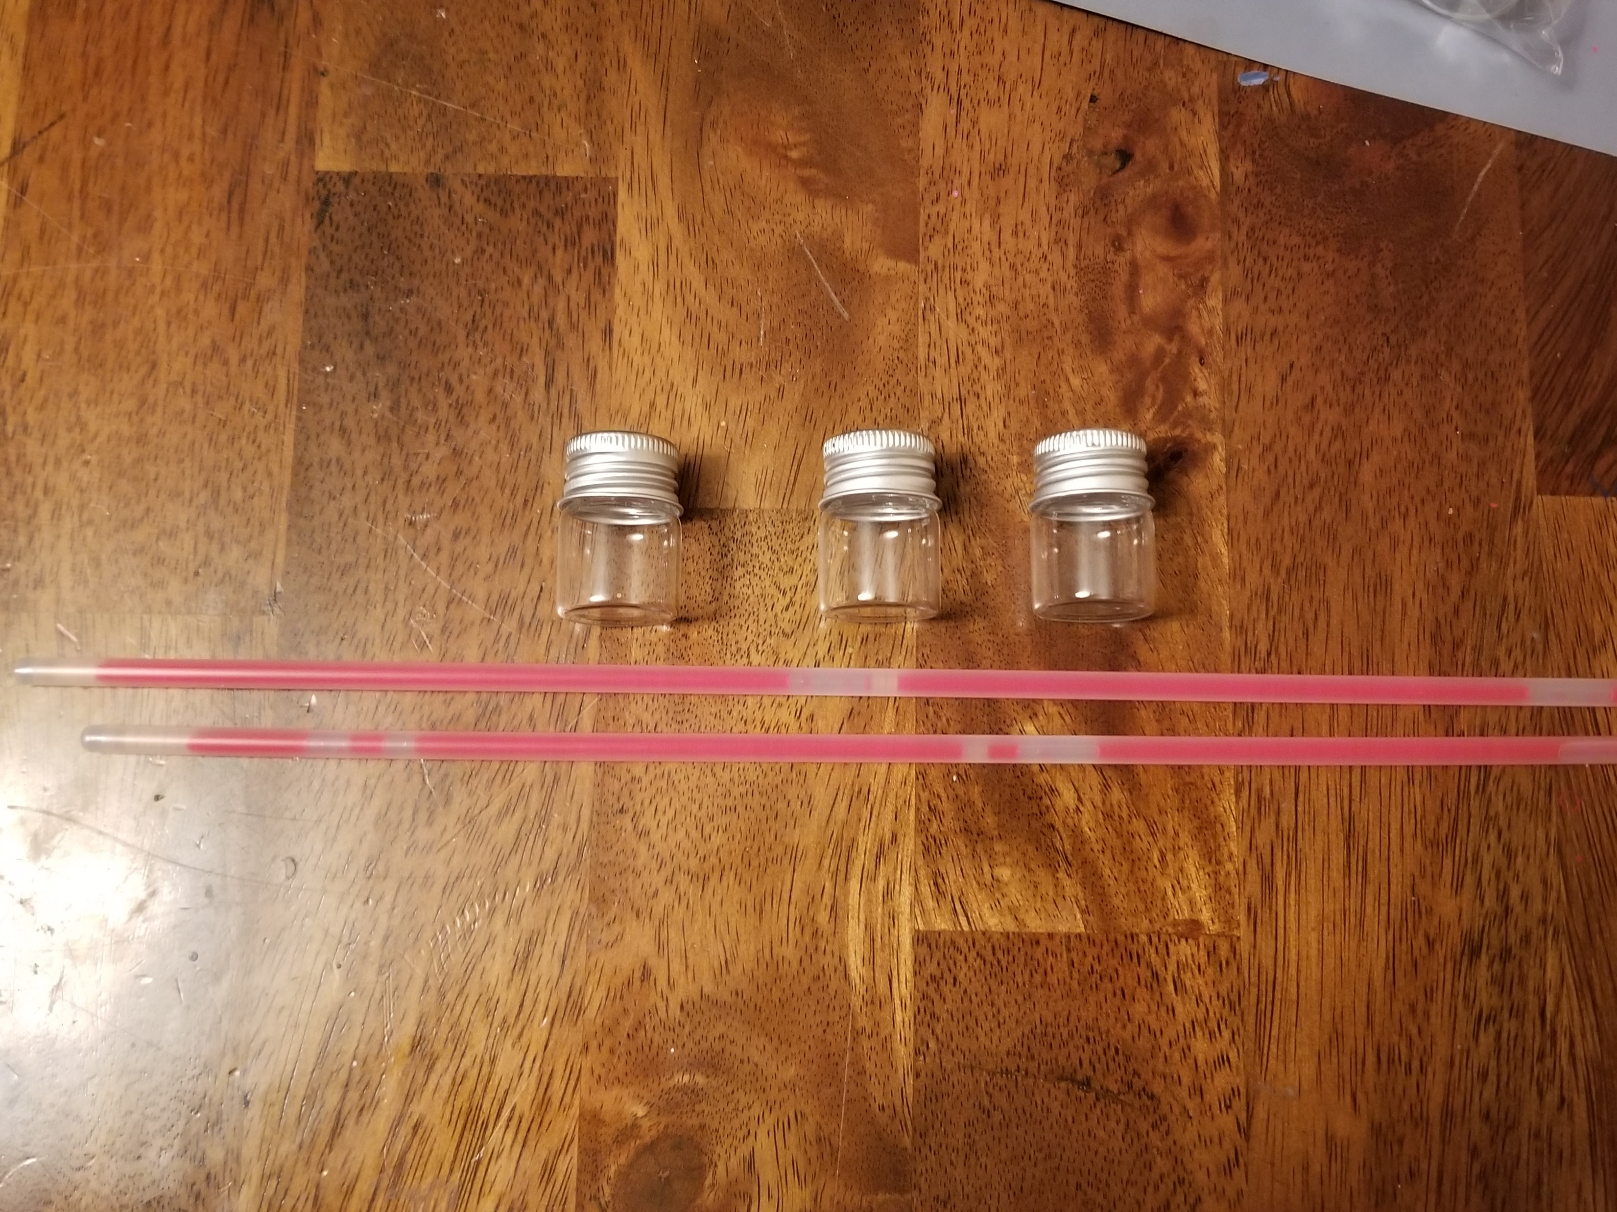
Demonstration time!
You’ll need:
Glow sticks (unbroken)
3 vials with lids
2 Pipettes
Scissors or Leatherman tool
Gloves
Mask (the chemicals are kind of stinky)
Safety glasses (in case you spill or when cutting the glowsticks)
Paper towels (for any oops messes)

Slide 8

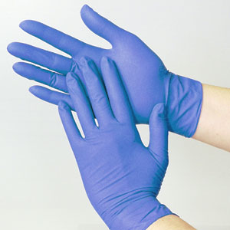
Let’s begin:
Prep your area to work
Put on your gloves

Slide 9
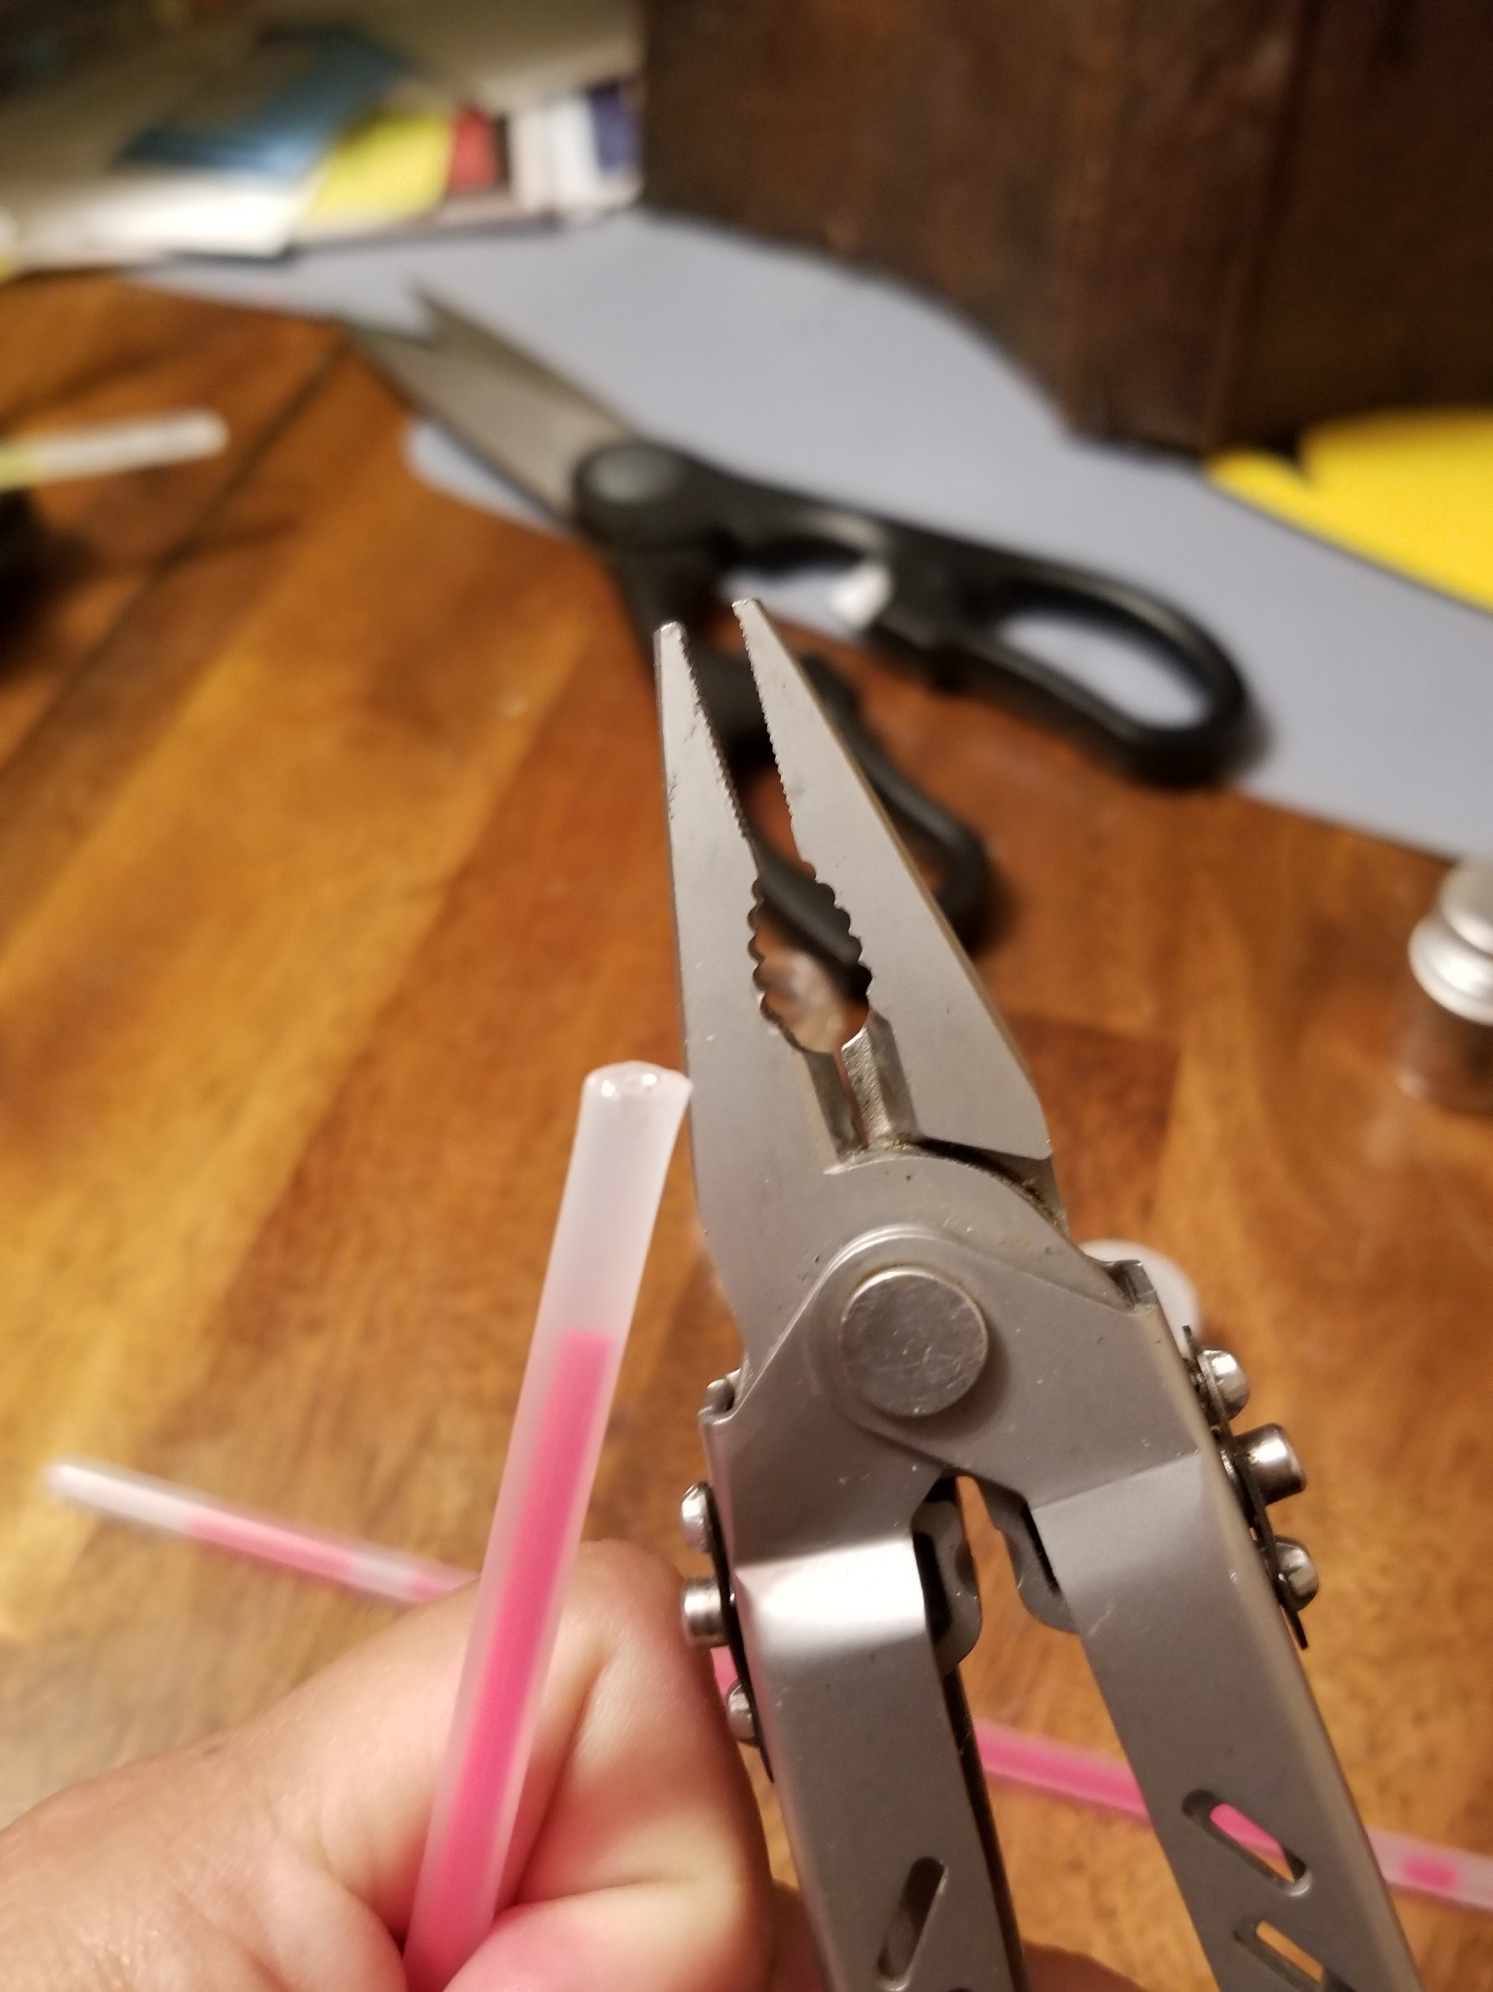
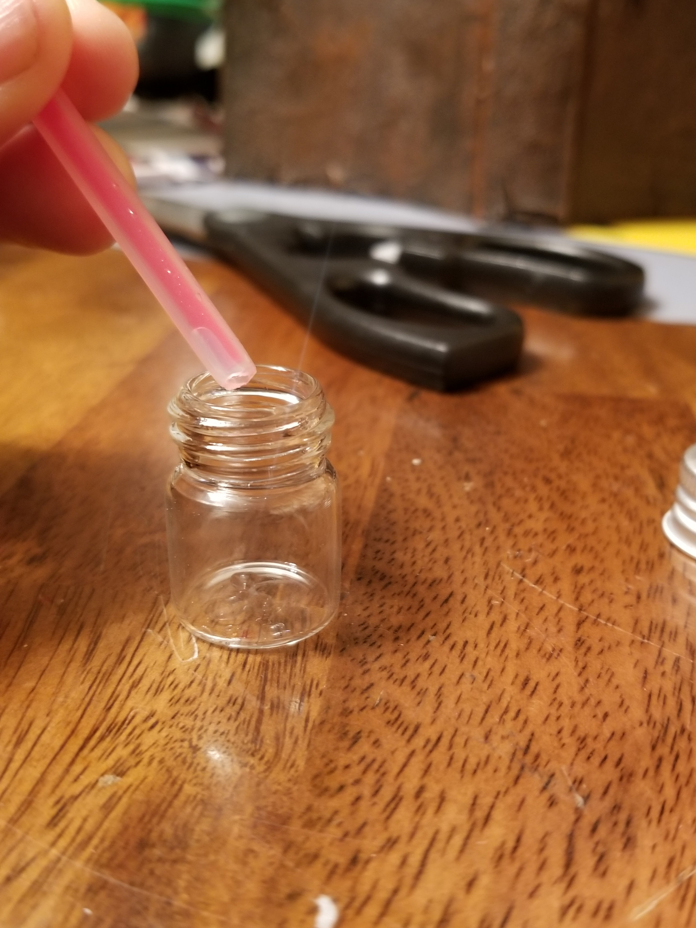
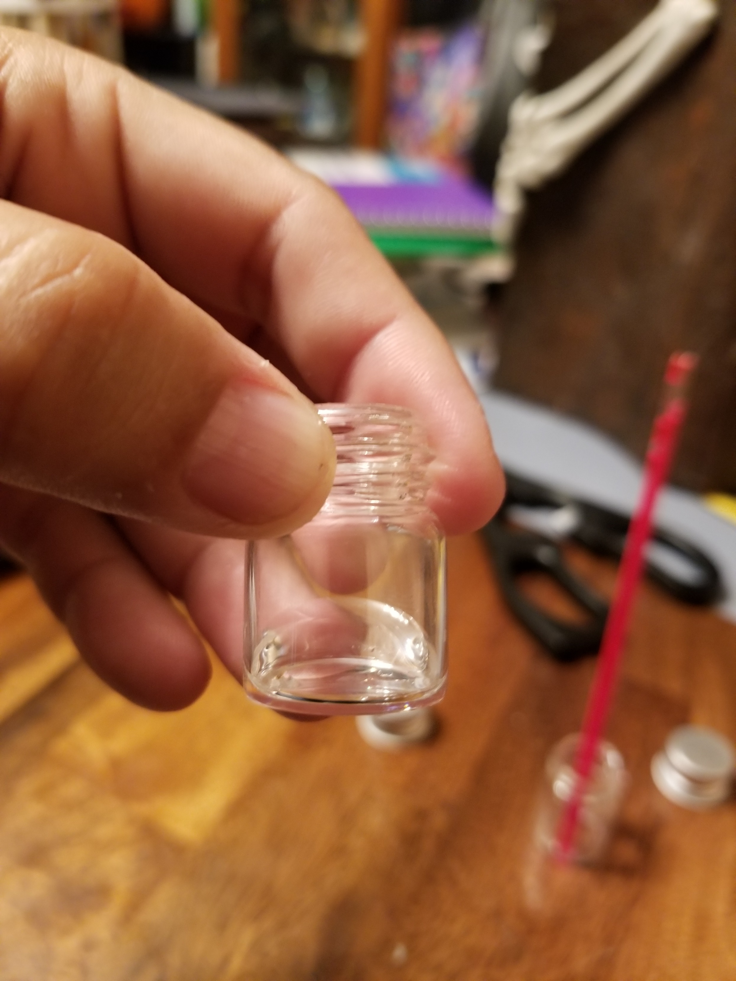
Next:
Carefully cut the tip of your glowstick. Do not bend or break your glowstick
Pour the clear contents of the glow stick into one of your open vials
  Be careful not to knock over your vial or spill the contents.

Slide 10
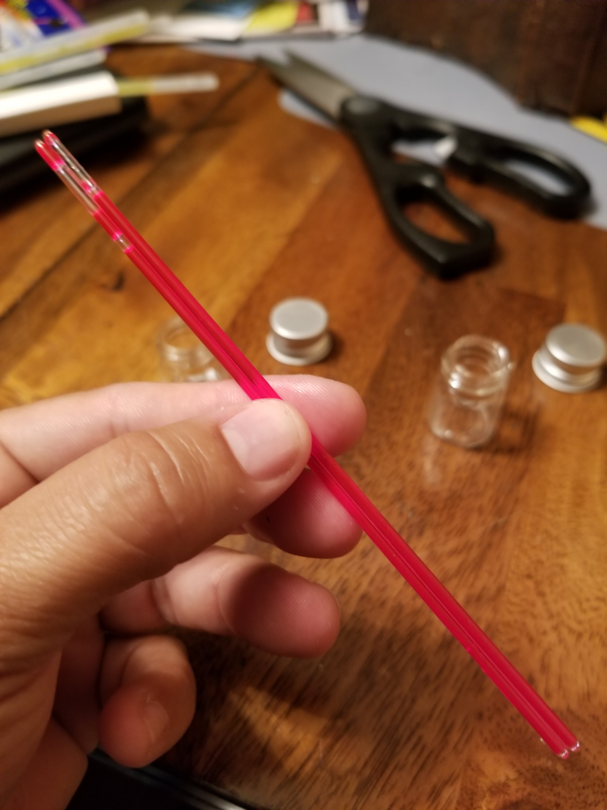
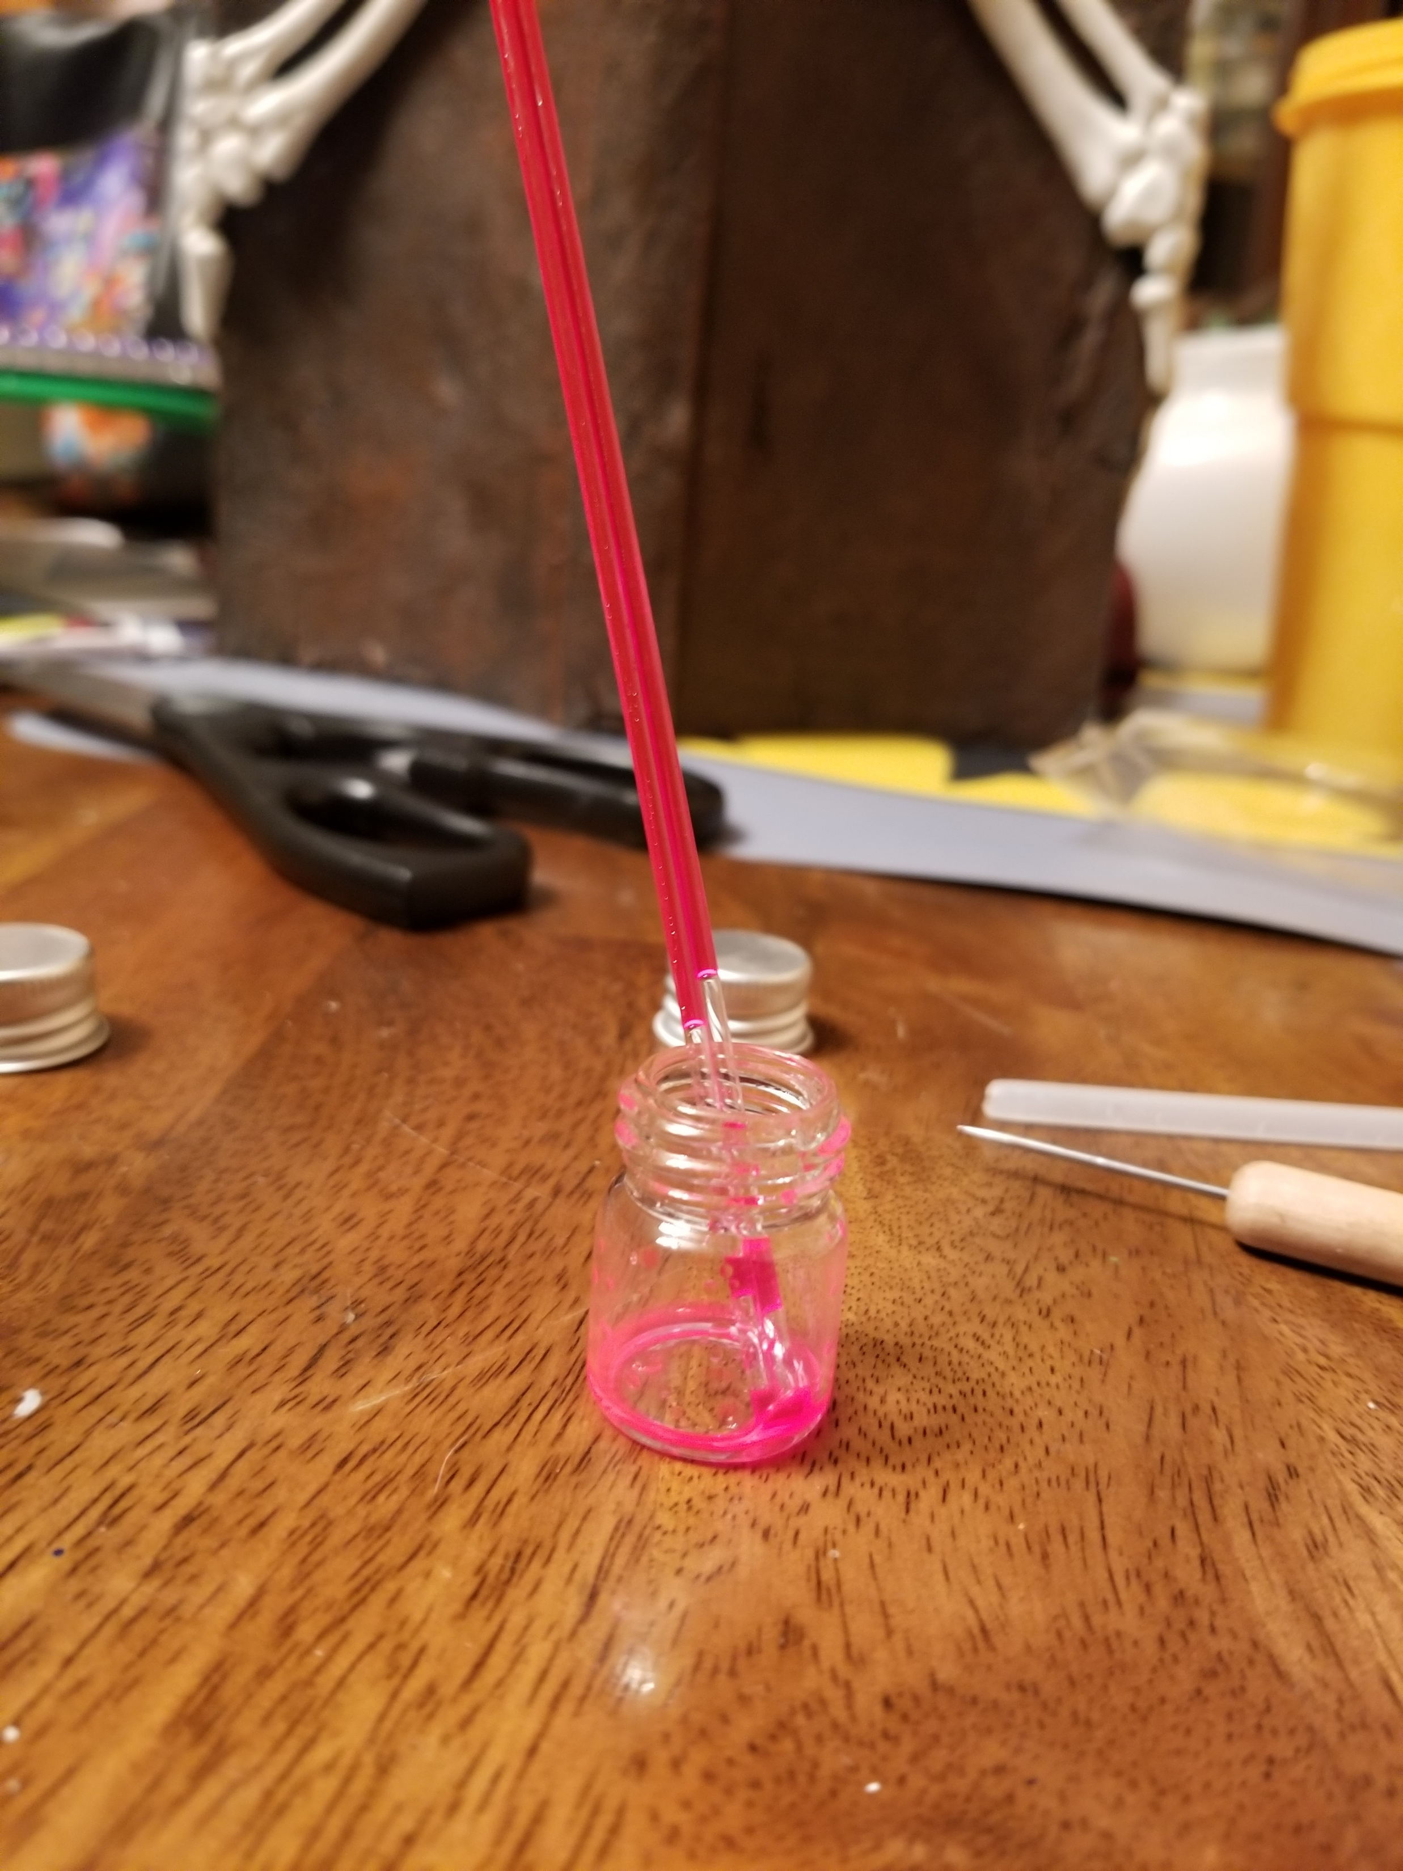
Next:
You’ll notice a glass tube with colorful liquid inside the glow stick.
  This has the second chemical you need.
Over a trashcan, carefully snip the tip of this vial with your Leatherman tool.
Pour these contents into your second vial.

Slide 11
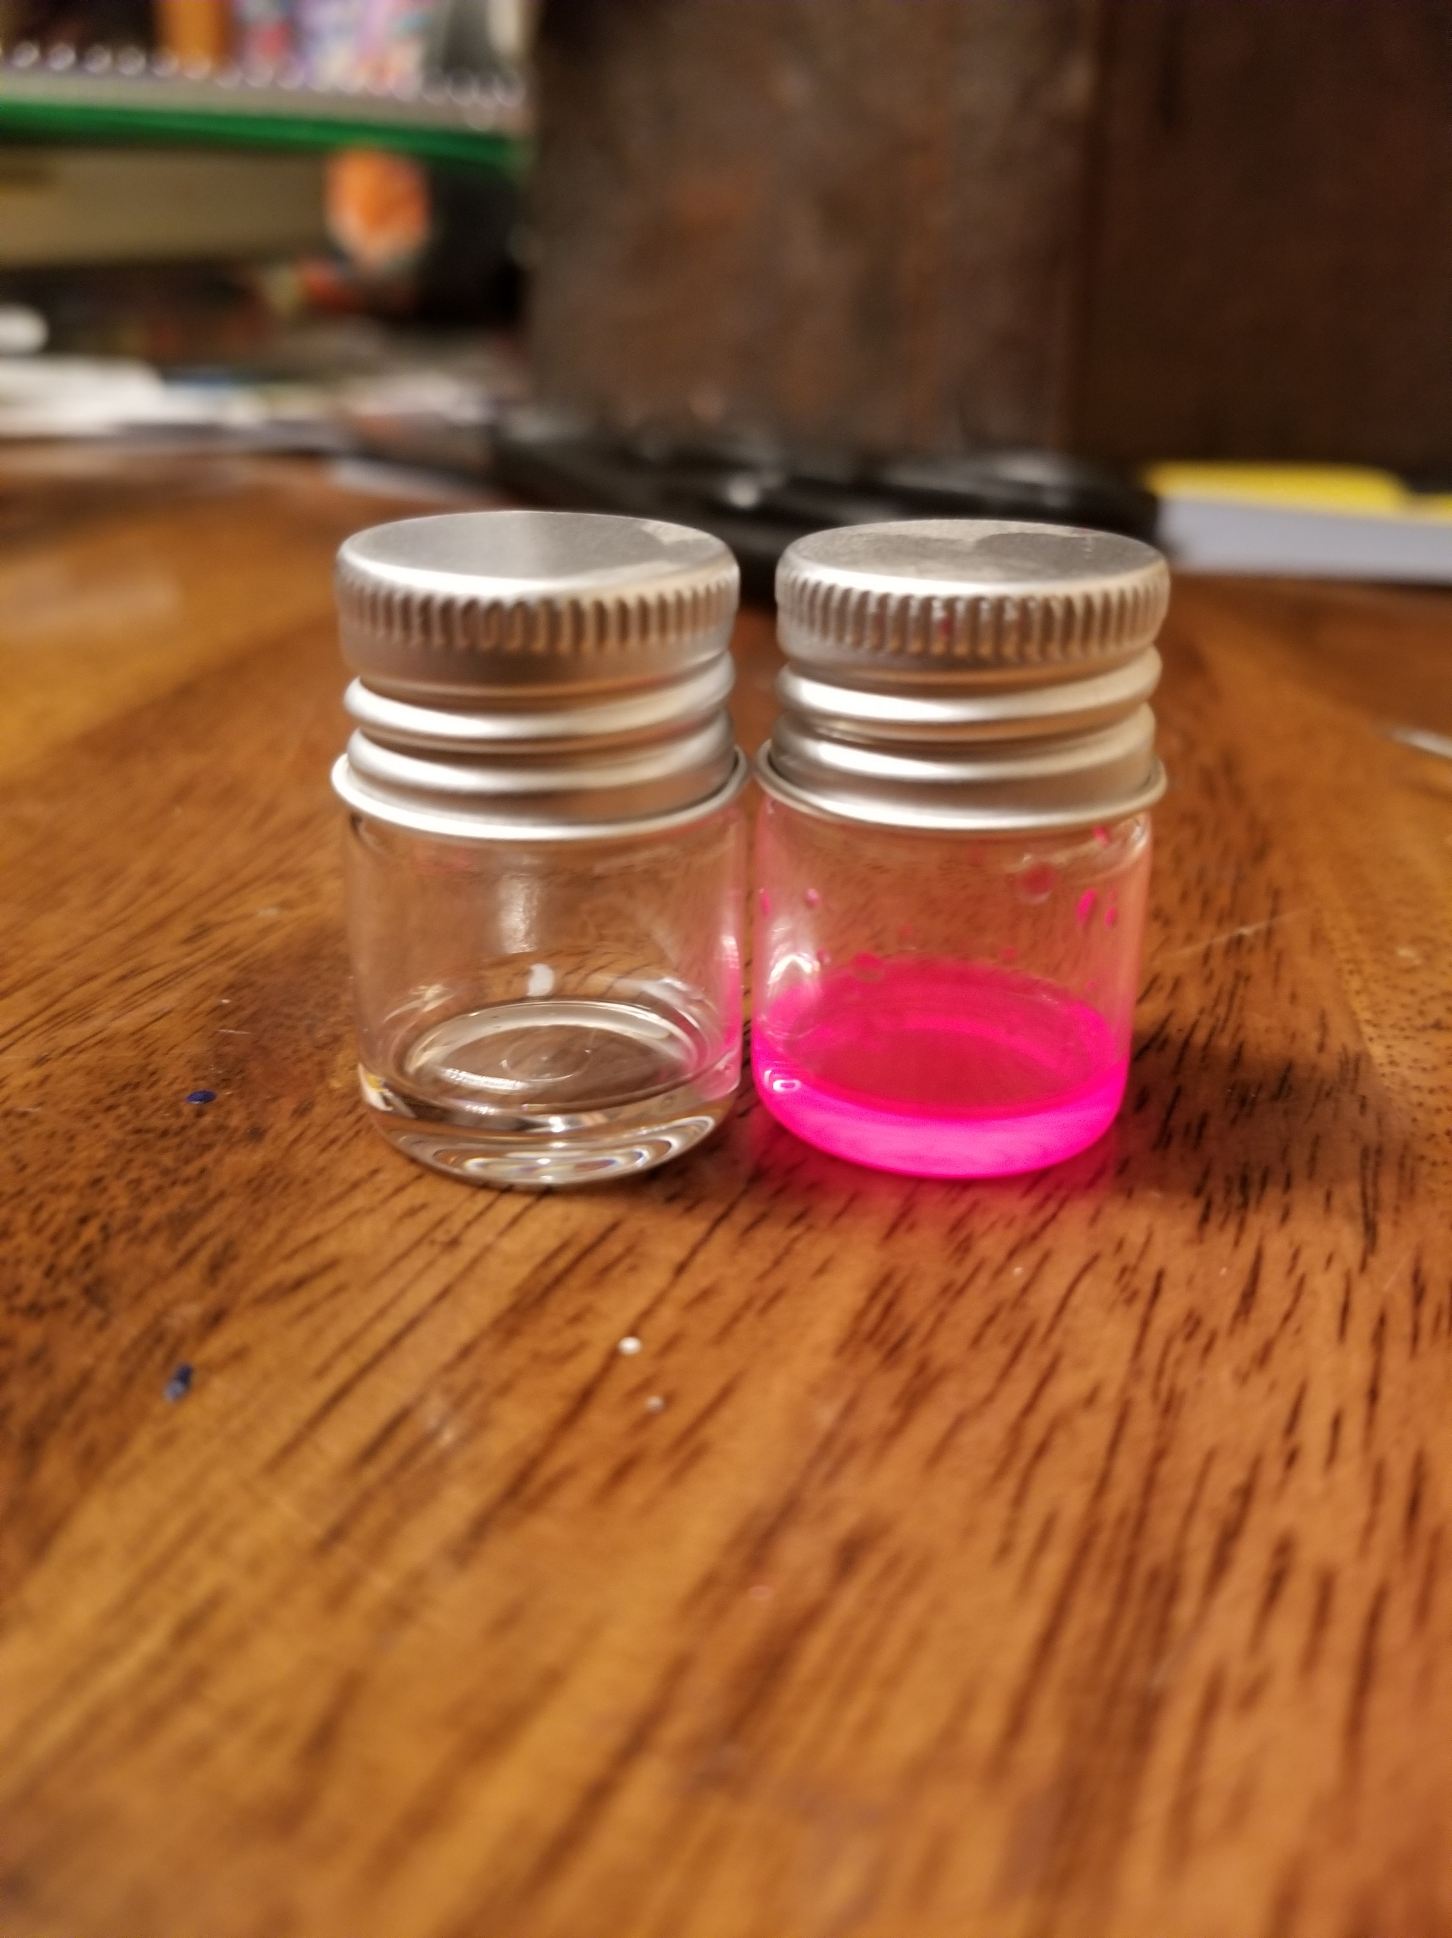
Now for the fun part!
Get your last empty vial and take off the lid.
Use 1 pipette to take out some of the clear liquid. This will represent Luciferin.
Use 1 pipette to take out some of the colorful liquid. This will represent Luciferase.

Slide 12
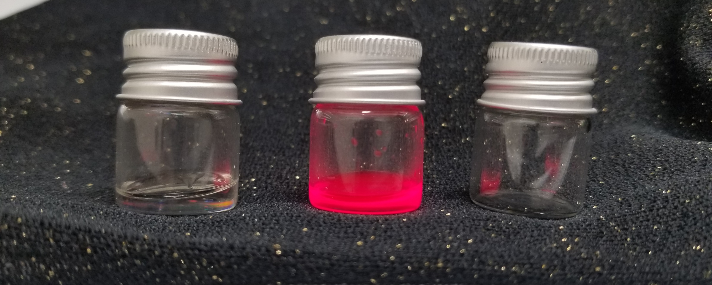
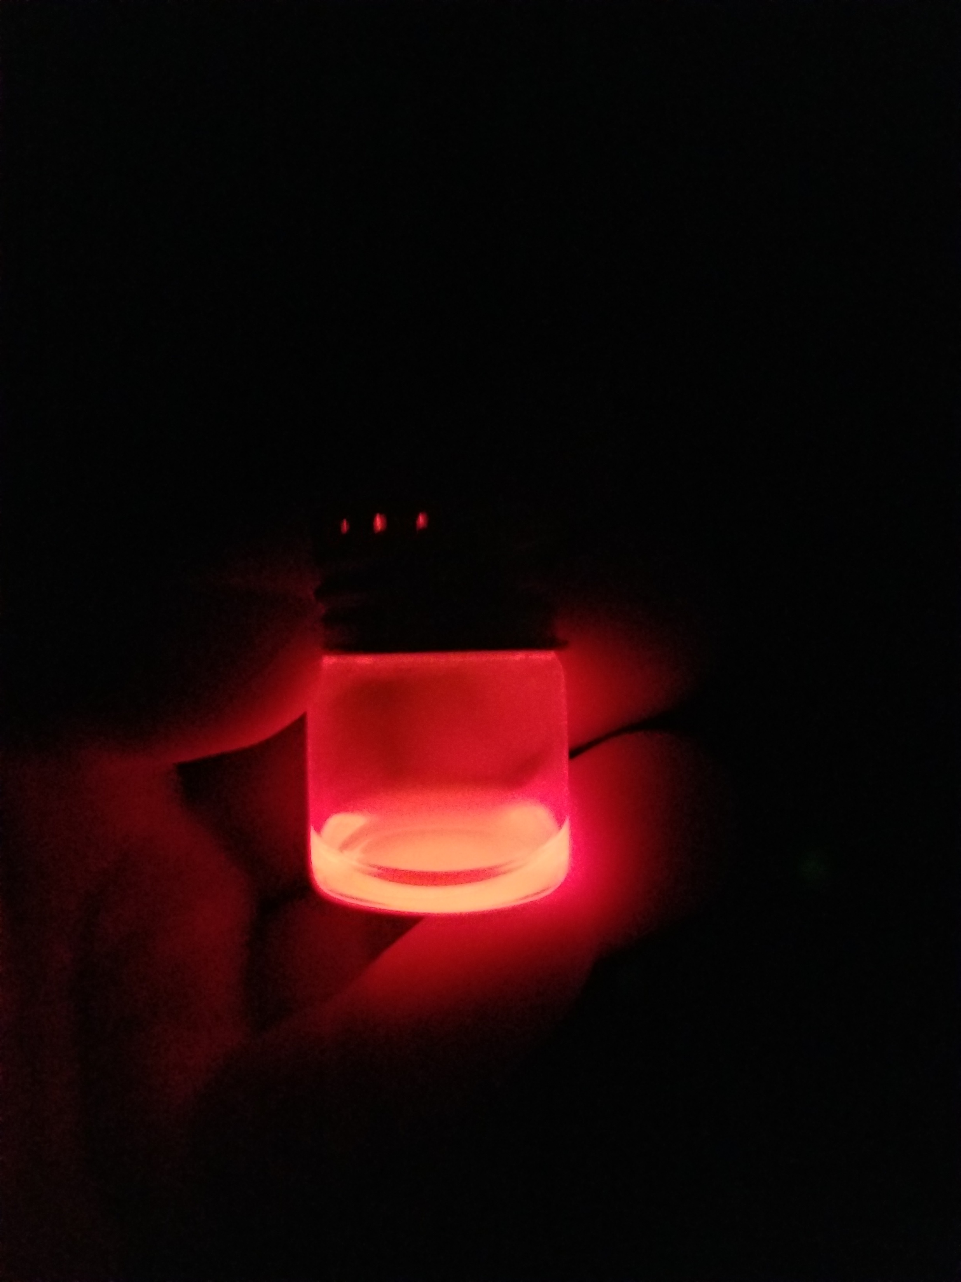
Now for the fun part!
Squeeze your pipette with the clear liquid (Luciferin) into your empty vial.
Squeeze your pipette with the colorful liquid (Luciferase) into the same vial.
Put the lid on the vial and shake gently.
Ta-Da you have the chemical reaction that has now made bioluminescence.
Final product after you have mixed the two chemicals together
(Luciferin) (Luciferase) Empty Jar

