Slide 1
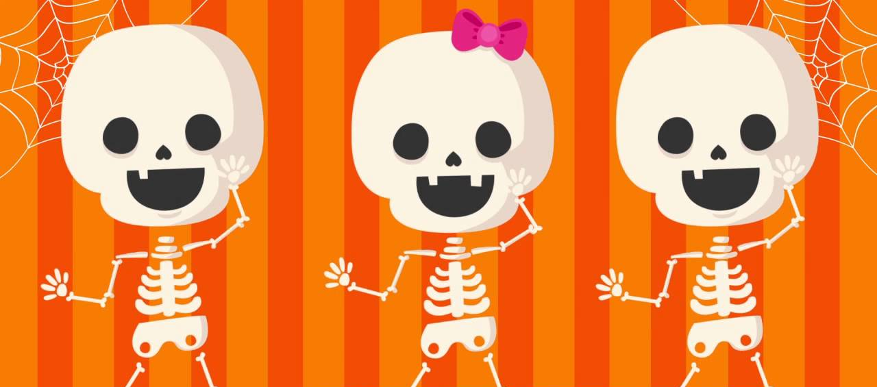
DANCING SKELETONS!
This Photo by Unknown Author is licensed under CC BY-NC-ND

Slide 2
The Science Behind Dancing Skeletons
Why do these things happen? Is it magic? No, it’s not magic; it’s static electricity!
Static electricity is the result of an imbalance between negative and positive charges in an object. These charges can build up on the surface of an object until they find a way to be released or discharged. One way to discharge them is through a circuit.

Slide 3
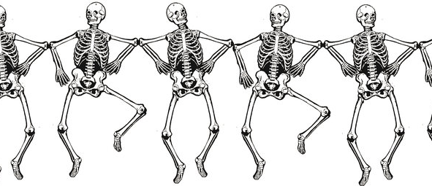
LET’S MAKE OUR DANCING SKELETONS!
This Photo by Unknown Author is licensed under CC BY-NC-ND

Slide 4
MATERIALS
Rice Paper
Balloons
Markers
Tape
Scissors

Slide 5
STEP 1
Using rice paper draw out your skeletons!

Slide 6
STEP 2
Cut out your skeletons

Slide 7
STEP 3
Tape skeletons feet to the table

Slide 8
STEP 4
Blow up a balloon

Slide 9
STEP 5
Draw a spooky face on your balloon!

Slide 10
STEP 6
Rub balloon on your head!

Slide 11
STEP 7
Move balloon over skeletons and watch them dance!

